Slide 1






Complaint Management System(For DISCOMs)

Slide 2

Contents
1)About Me
2)Abstract
3)Programming Language and Tools Used
4)What is used?
5) Explanation

Slide 3

Name: Akshay Thakur
Enrollment No: 21162121001
Batch:32
Branch:BDA
Subject-OOP

Slide 4
Abstract
This report includes the presentation of Complaint Management System(For Discoms) by which complaints can be handled very easily and efficiently it uses JDBC to store and retrieve complaints from the database.
It is a console based application.

Slide 5
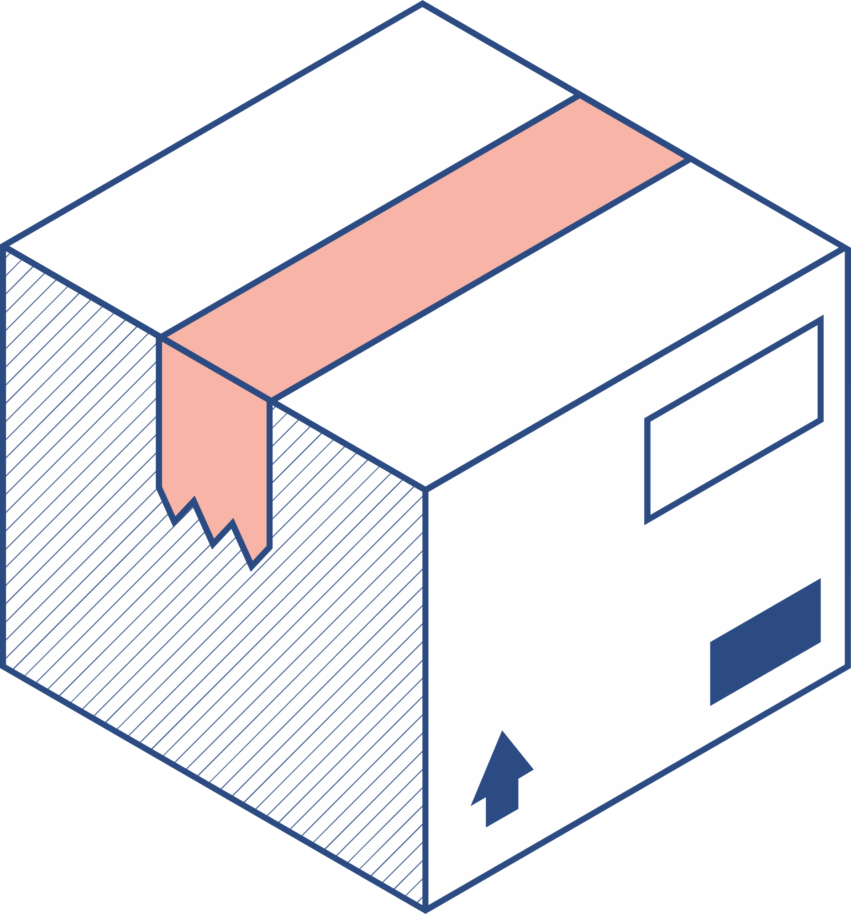


Programming Language and Tools
Used
1)Programming Language Used-Java
2)Technologies Used -JDBC API
3)IDE-Intellij IDEA

Slide 6


What is Used?
LOOPS
Switch-Case
SQL queries
JDBC
IF-ELSE
Exception Handling
Methods

Slide 7
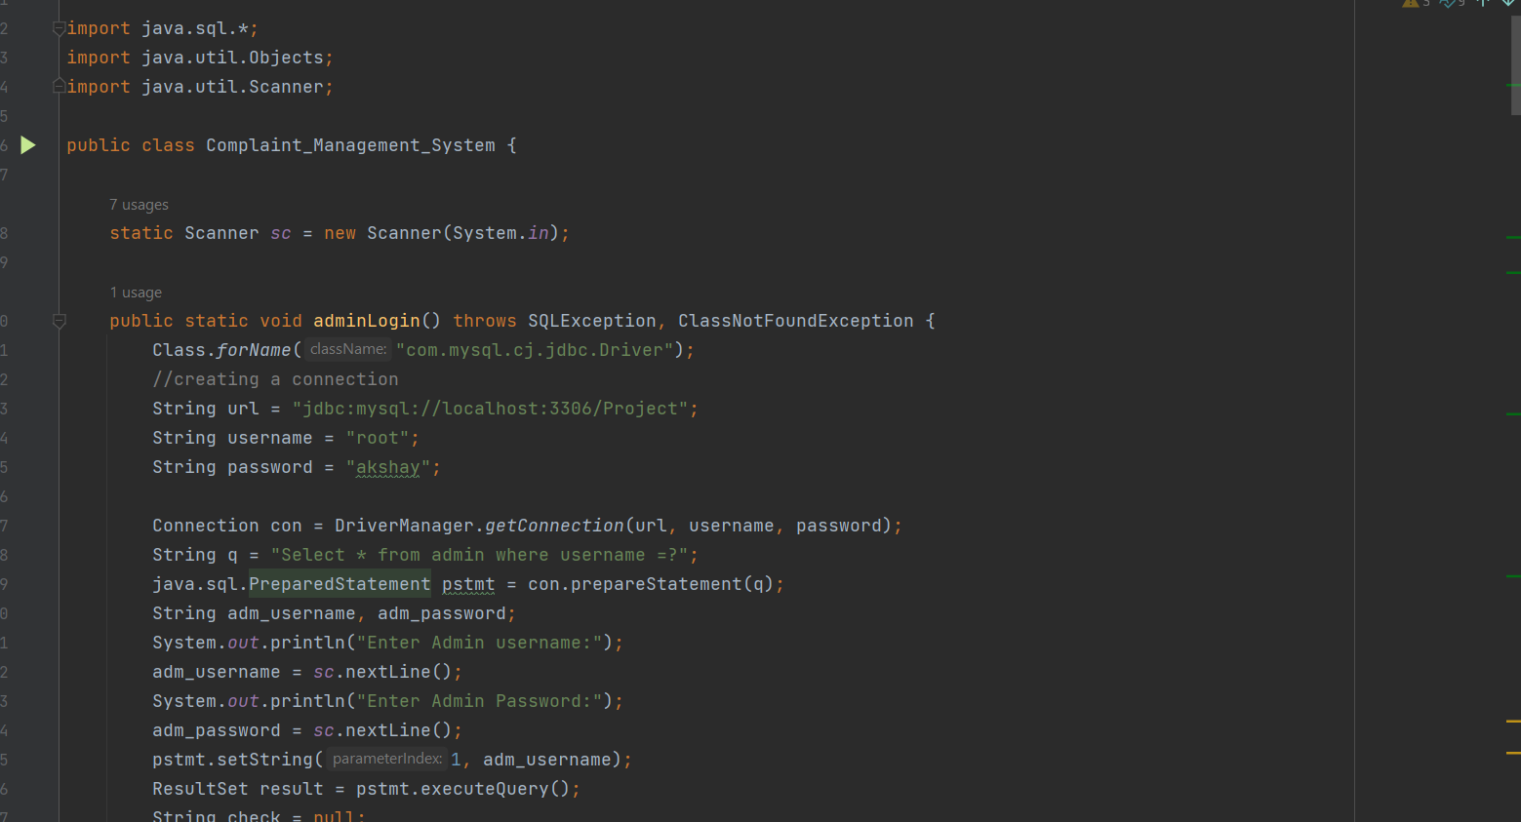
Screenshots

Slide 8
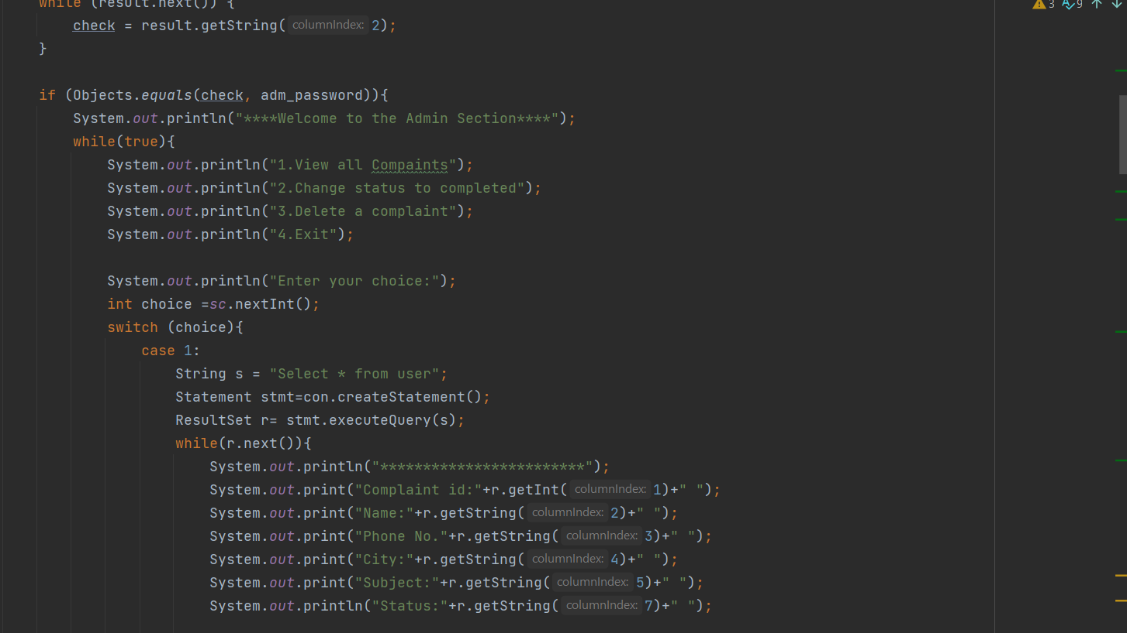

Slide 9
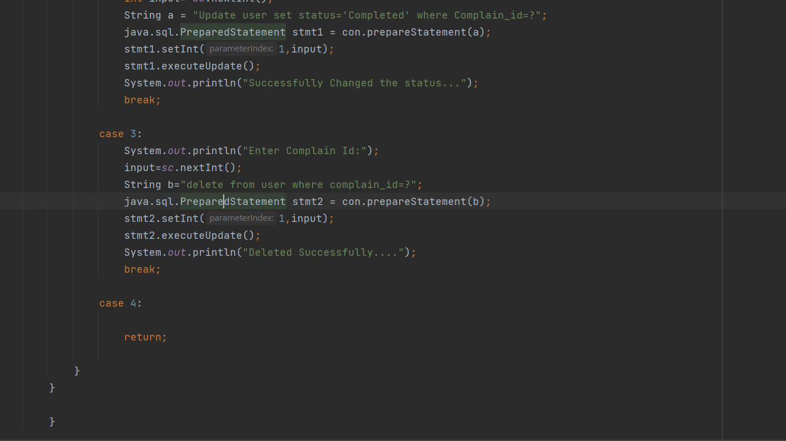

Slide 10
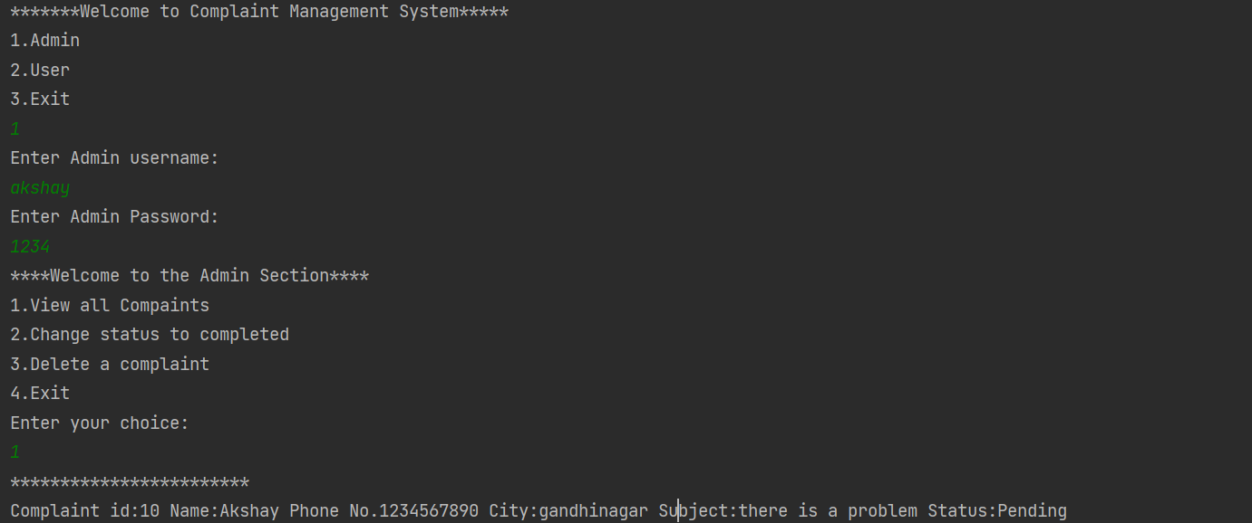
Output Screenshot
1)View Records
e1

Slide 11
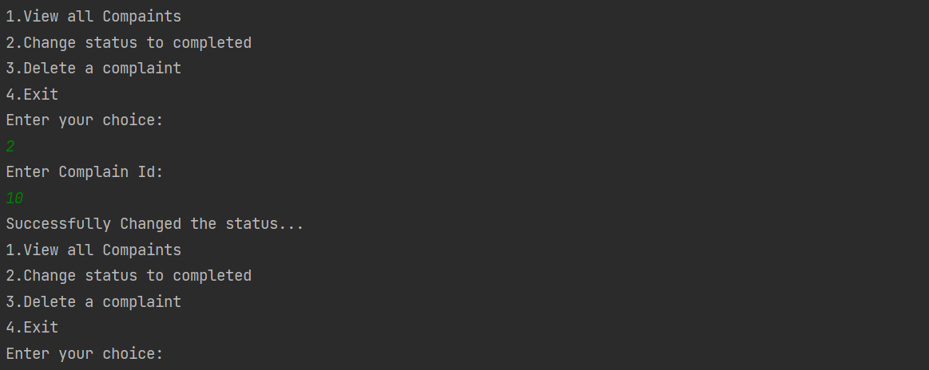
2)Changing Status to Completed
Cha

Slide 12
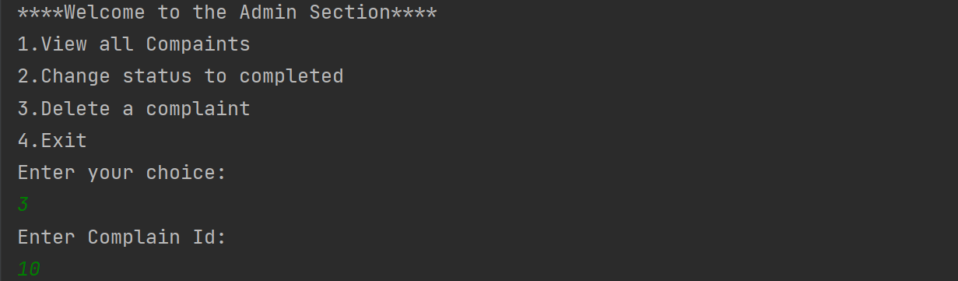
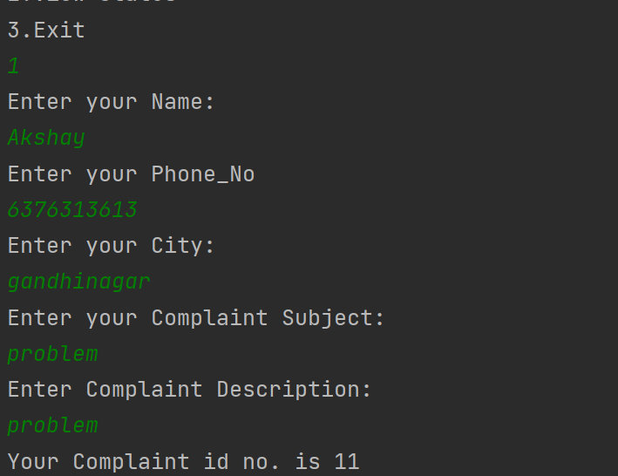
3)Deleting a Complaint
4)Registration of complaint

Slide 13
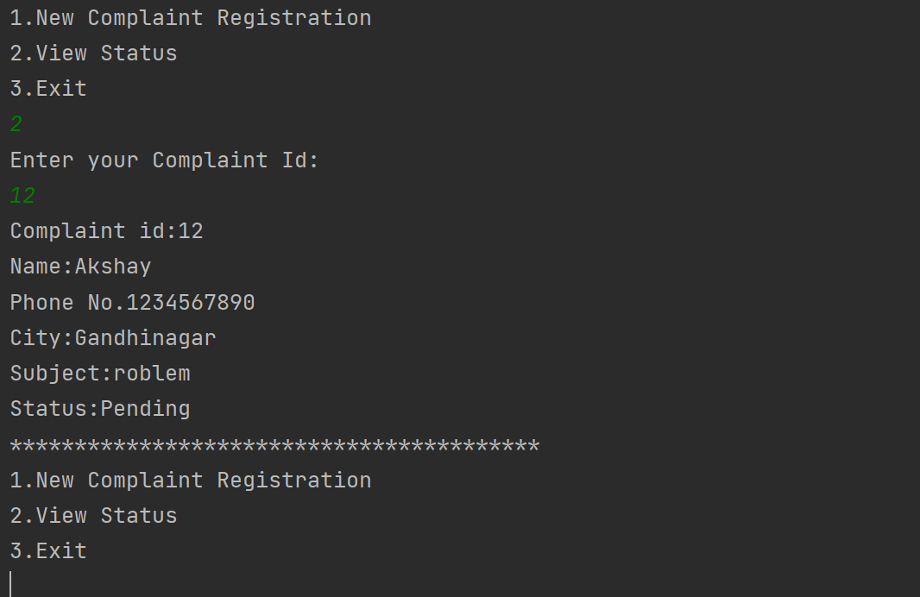
5) Checking Status of Complaint

Slide 14
Features of Complaint Management System
By Using this system a user can register his/her complain and can see the status of his/her complain by entering the complaint id. Admin gets the privilages to view all complaint, delete complaint,change the status to completed.

Slide 15
Packages Used
1) Java.Lang:Provides classes that are fundamental to the design of the Java programming language. The most important classes are Object, which is the root of the class hierarchy, and Class, instances of which represent classes at run time.
2)Java.sql:Provides the API for accessing and processing data stored in a data source (usually a relational database) using the Java™ programming language
3)Java.util:Contains the collections framework, some internationalization support classes, a service loader, properties, random number generation, string parsing and scanning classes, base64 encoding and decoding, a bit array, and several miscellaneous utility classes.

Slide 16



